Slide 1

Machine learning course
Presented by Abdel Rahman AlSabbagh
Lecture #1 – Tue - 10.5.2023

Slide 2


Tech Requirements
In the name of Allah, the most gracious, the most merciful, we start :)
Machine Learning Course
Abdel Rahman AlSabbagh

Slide 3
Tech Requirements
Let’s do some EDA
(´⊙ω⊙`)
Machine Learning Course
Abdel Rahman AlSabbagh

Slide 4
Tech Requirements
Today’s Quote
“The man who asks a question is a fool for a minute,
the man who does not ask is a fool for life.”
- Confucius
Machine Learning Course
Abdel Rahman AlSabbagh
Notes:
When most people hear “Machine Learning,” they picture a robot: a dependable butler
or a deadly Terminator depending on who you ask. But Machine Learning is not
just a futuristic fantasy, it’s already here. In fact, it has been around for decades in
some specialized applications, such as Optical Character Recognition (OCR). But the
first ML application that really became mainstream, improving the lives of hundreds
of millions of people, took over the world back in the 1990s: it was the spam filter.
Not exactly a self-aware Skynet, but it does technically qualify as Machine Learning
(it has actually learned so well that you seldom need to flag an email as spam anymore).
It was followed by hundreds of ML applications that now quietly power hundreds
of products and features that you use regularly, from better recommendations
to voice search.
Where does Machine Learning start and where does it end? What exactly does it
mean for a machine to learn something? If I download a copy of Wikipedia, has my
computer really “learned” something? Is it suddenly smarter? In this chapter we will
start by clarifying what Machine Learning is and why you may want to use it.
Then, before we set out to explore the Machine Learning continent, we will take a
look at the map and learn about the main regions and the most notable landmarks:
supervised versus unsupervised learning, online versus batch learning, instance-based
versus model-based learning. Then we will look at the workflow of a typical ML
project, discuss the main challenges you may face, and cover how to evaluate and
fine-tune a Machine Learning system.

Slide 5

Tech Requirements
Motivation
When most people hear “Machine Learning,” they picture a robot: a dependable butler or a deadly Terminator depending on who you ask.
But Machine Learning is not just a futuristic fantasy,
it’s already here.
Machine Learning Course
Abdel Rahman AlSabbagh
Notes:
When most people hear “Machine Learning,” they picture a robot: a dependable butler
or a deadly Terminator depending on who you ask. But Machine Learning is not
just a futuristic fantasy, it’s already here. In fact, it has been around for decades in
some specialized applications, such as Optical Character Recognition (OCR). But the
first ML application that really became mainstream, improving the lives of hundreds
of millions of people, took over the world back in the 1990s: it was the spam filter.
Not exactly a self-aware Skynet, but it does technically qualify as Machine Learning
(it has actually learned so well that you seldom need to flag an email as spam anymore).
It was followed by hundreds of ML applications that now quietly power hundreds
of products and features that you use regularly, from better recommendations
to voice search.
Where does Machine Learning start and where does it end? What exactly does it
mean for a machine to learn something? If I download a copy of Wikipedia, has my
computer really “learned” something? Is it suddenly smarter? In this chapter we will
start by clarifying what Machine Learning is and why you may want to use it.
Then, before we set out to explore the Machine Learning continent, we will take a
look at the map and learn about the main regions and the most notable landmarks:
supervised versus unsupervised learning, online versus batch learning, instance-based
versus model-based learning. Then we will look at the workflow of a typical ML
project, discuss the main challenges you may face, and cover how to evaluate and
fine-tune a Machine Learning system.

Slide 6



Tech Requirements
Motivation – You Use ML Everyday
Machine Learning Course
Abdel Rahman AlSabbagh
Notes:
Using machine learning everyday without even knowing it

Slide 7


Tech Requirements
Motivation – You Use ML Everyday
Machine Learning Course
Abdel Rahman AlSabbagh
Notes:
Using machine learning everyday without even knowing it

Slide 8


Tech Requirements
Motivation – You Use ML Everyday
Machine Learning Course
Abdel Rahman AlSabbagh
Notes:
Using machine learning everyday without even knowing it

Slide 9
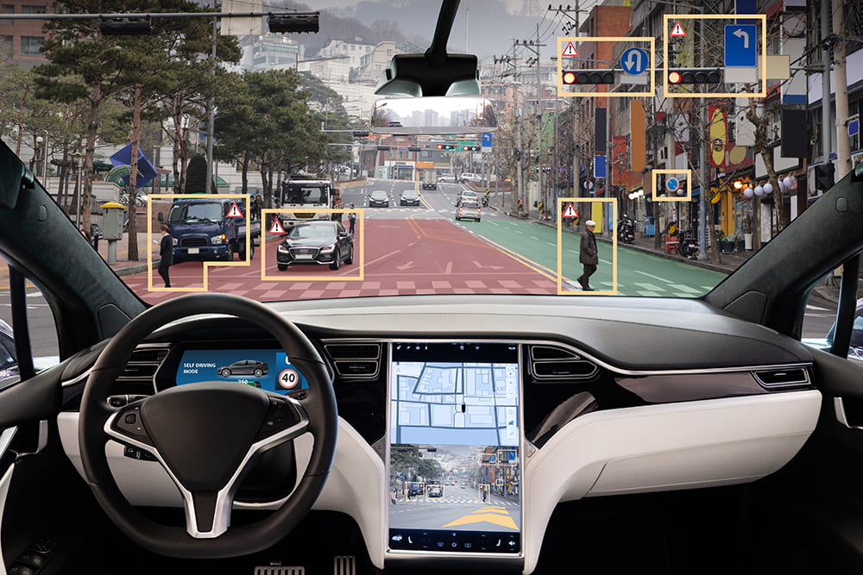
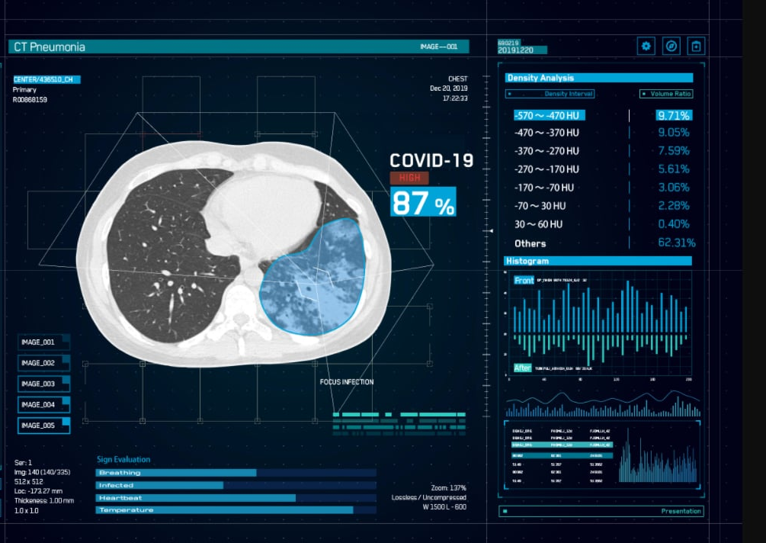
Tech Requirements
Motivation – Other ML Applications
Machine Learning Course
Abdel Rahman AlSabbagh

Slide 10



Tech Requirements
Motivation – Other ML Applications
Machine Learning Course
Abdel Rahman AlSabbagh

Slide 11
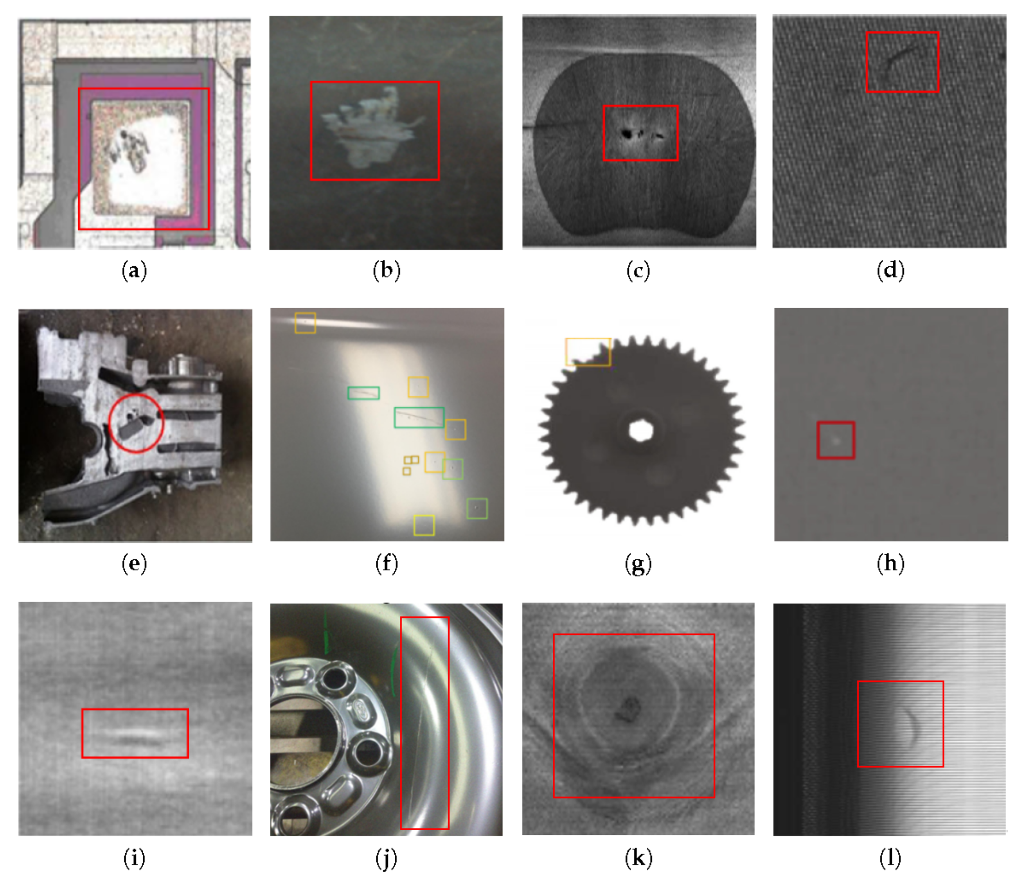
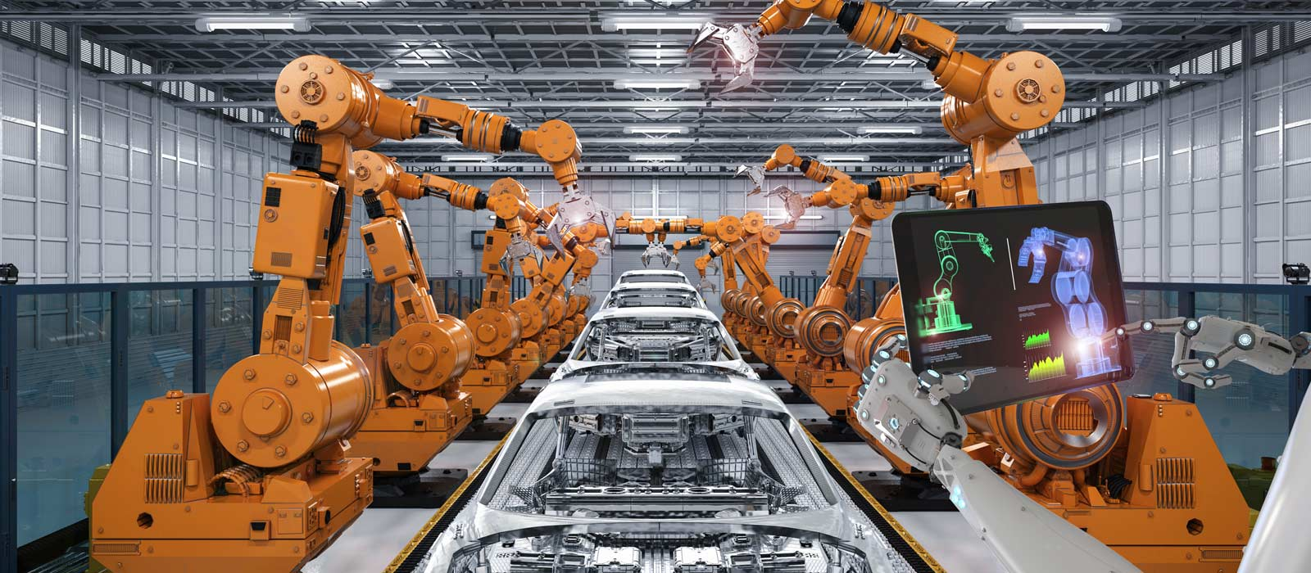
Tech Requirements
Motivation – Other ML Applications
Machine Learning Course
Abdel Rahman AlSabbagh

Slide 12


Tech Requirements
Motivation – Other ML Applications
Machine Learning Course
Abdel Rahman AlSabbagh

Slide 13



Tech Requirements
Motivation – Other ML Applications
Machine Learning Course
Abdel Rahman AlSabbagh

Slide 14
Tech Requirements
Motivation – Other ML Applications
Can you think of one?
Machine Learning Course
Abdel Rahman AlSabbagh

Slide 15
Tech Requirements
So, What is Machine Learning in a sentence?
It's the science of getting computers to learn without being explicitly programmed.
Machine Learning Course
Abdel Rahman AlSabbagh

Slide 16
Tech Requirements
Prerequisites
We expect you to have knowledge in:
Programming, specifically in Python programming language.
Data preprocessing techniques.
Principles of statistics, calculus, and linear algebra.
Machine Learning Course
Abdel Rahman AlSabbagh

Slide 17
Tech Requirements
Grading
In order to get a certificate for this course, you should pass the grade of 85%, that is through completion of:
Assignments (50%).
Attendance (20%).
Final Project (30%).
Machine Learning Course
Abdel Rahman AlSabbagh

Slide 18
Tech Requirements
Expectations
You should expect us to provide the knowledge you need to start your journey in Machine Learning.
We expect from you commitment, and enthusiasm.
Machine Learning Course
Abdel Rahman AlSabbagh

Slide 19
Tech Requirements
Course Outline
Machine Learning Overview
The Machine Learning Process
Introduction to Classification
Machine Learning Model Training
Support Vector Machines
Decision Trees
Ensemble Learning and Random Forests
Unsupervised Learning Techniques
Artificial Neural Networks
Resources used:
Hands-on Machine Learning with Scikit-Learn, Keras, and TensorFlow by Aurélien Géron
Machine Learning Specialization by Andrew Ng and Stanford Online
Machine Learning Course
Abdel Rahman AlSabbagh

Slide 20
Tech Requirements
Machine Learning Overview
Topics covered in this section include:
What Is Machine Learning.
Why Use Machine Learning?.
Types of Machine Learning Systems.
Main Challenges of Machine Learning.
Testing and Validating.
Exercises.
Machine Learning Course
Abdel Rahman AlSabbagh

Slide 21
Tech Requirements
What Is Machine Learning?
Machine Learning is the science (and art) of programming computers so they can
learn from data.
A slightly more general definition:
The field of study that gives computers the ability to learn without being explicitly programmed.
- Arthur Samuel, 1959
A more engineering-oriented one:
A computer program is said to learn from experience E with respect to some task T
and some performance measure P, if its performance on T, as measured by P, improves
with experience E.
- Tom Mitchell, 1997
Machine Learning Course
Abdel Rahman AlSabbagh
Notes:
For example, your spam filter is a Machine Learning program that can learn to flag
spam given examples of spam emails (e.g., flagged by users) and examples of regular
(nonspam, also called “ham”) emails. The examples that the system uses to learn are
called the training set. Each training example is called a training instance (or sample).
In this case, the task T is to flag spam for new emails, the experience E is the training
data, and the performance measure P needs to be defined; for example, you can use
the ratio of correctly classified emails. This particular performance measure is called
accuracy and it is often used in classification tasks.
If you just download a copy of Wikipedia, your computer has a lot more data, but it is
not suddenly better at any task. Thus, it is not Machine Learning.

Slide 22
Tech Requirements
Why Use Machine Learning?
Let’s take the example of spam filtering in both traditional approach and Machine Learning approach.
Traditional approach
Machine Learning Course
Abdel Rahman AlSabbagh
Notes:
Consider how you would write a spam filter using traditional programming techniques
1. First you would look at what spam typically looks like. You might notice that
some words or phrases (such as “4U,” “credit card,” “free,” and “amazing”) tend to
come up a lot in the subject. Perhaps you would also notice a few other patterns
in the sender’s name, the email’s body, and so on.
2. You would write a detection algorithm for each of the patterns that you noticed,
and your program would flag emails as spam if a number of these patterns are
detected.
3. You would test your program, and repeat steps 1 and 2 until it is good enough.
Since the problem is not trivial, your program will likely become a long list of complex
rules—pretty hard to maintain.

Slide 23
Tech Requirements
Why Use Machine Learning?
Let’s take the example of spam filtering in both traditional approach and Machine Learning approach.
Machine Learning approach
Machine Learning Course
Abdel Rahman AlSabbagh
Notes:
In contrast, a spam filter based on Machine Learning techniques automatically learns
which words and phrases are good predictors of spam by detecting unusually frequent
patterns of words in the spam examples compared to the ham examples.
The program is much shorter, easier to maintain, and most likely more
accurate.
Moreover, if spammers notice that all their emails containing “4U” are blocked, they
might start writing “For U” instead. A spam filter using traditional programming
techniques would need to be updated to flag “For U” emails. If spammers keep working
around your spam filter, you will need to keep writing new rules forever.

Slide 24
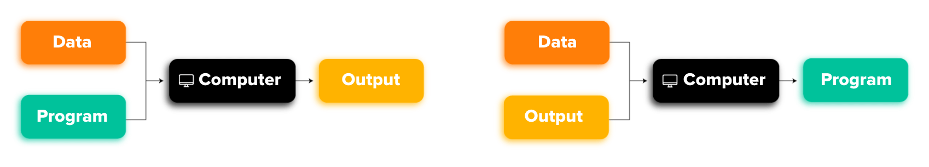
Tech Requirements
Why Use Machine Learning?
Traditional approach
Machine Learning approach
Machine Learning Course
Abdel Rahman AlSabbagh
Notes:
In contrast, a spam filter based on Machine Learning techniques automatically learns
which words and phrases are good predictors of spam by detecting unusually frequent
patterns of words in the spam examples compared to the ham examples.
The program is much shorter, easier to maintain, and most likely more
accurate.
Moreover, if spammers notice that all their emails containing “4U” are blocked, they
might start writing “For U” instead. A spam filter using traditional programming
techniques would need to be updated to flag “For U” emails. If spammers keep working
around your spam filter, you will need to keep writing new rules forever.

Slide 25
Tech Requirements
Why Use Machine Learning?
Let’s take the example of spam filtering in both traditional approach and Machine Learning approach.
Automatically adapting to change
Machine Learning Course
Abdel Rahman AlSabbagh
Notes:
In contrast, a spam filter based on Machine Learning techniques automatically notices
that “For U” has become unusually frequent in spam flagged by users, and it starts
flagging them without your intervention.
Another area where Machine Learning shines is for problems that either are too complex
for traditional approaches or have no known algorithm. For example, consider
speech recognition: say you want to start simple and write a program capable of distinguishing
the words “one” and “two.” You might notice that the word “two” starts
with a high-pitch sound (“T”), so you could hardcode an algorithm that measures
high-pitch sound intensity and use that to distinguish ones and twos. Obviously this
technique will not scale to thousands of words spoken by millions of very different
people in noisy environments and in dozens of languages. The best solution (at least
today) is to write an algorithm that learns by itself, given many example recordings
for each word.

Slide 26
Tech Requirements
Why Use Machine Learning?
Let’s take the example of spam filtering in both traditional approach and Machine Learning approach.
Machine Learning can help humans learn
Machine Learning Course
Abdel Rahman AlSabbagh
Notes:
Finally, Machine Learning can help humans learn: ML algorithms can be
inspected to see what they have learned (although for some algorithms this can be
tricky). For instance, once the spam filter has been trained on enough spam, it can
easily be inspected to reveal the list of words and combinations of words that it
believes are the best predictors of spam. Sometimes this will reveal unsuspected correlations
or new trends, and thereby lead to a better understanding of the problem.
Applying ML techniques to dig into large amounts of data can help discover patterns
that were not immediately apparent. This is called data mining.

Slide 27
Tech Requirements
Why Use Machine Learning?
To summarize, Machine Learning is great for:
Problems for which existing solutions require a lot of hand-tuning or long lists of rules: one Machine Learning algorithm can often simplify code and perform better.
Complex problems for which there is no good solution at all using a traditional approach: the best Machine Learning techniques can find a solution.
Fluctuating environments: a Machine Learning system can adapt to new data.
Getting insights about complex problems and large amounts of data.
Machine Learning Course
Abdel Rahman AlSabbagh

Slide 28
Tech Requirements
Types of Machine Learning Systems
There are so many different types of Machine Learning systems that it is useful to
classify them in broad categories based on:
Whether or not they are trained with human supervision (supervised, unsupervised, semisupervised, and Reinforcement Learning)
Whether or not they can learn incrementally on the fly (online versus batch learning)
Whether they work by simply comparing new data points to known data points, or instead detect patterns in the training data and build a predictive model, much like scientists do (instance-based versus model-based learning)
Machine Learning Course
Abdel Rahman AlSabbagh
Notes:
These criteria are not exclusive; you can combine them in any way you like. For
example, a state-of-the-art spam filter may learn on the fly using a deep neural network
model trained using examples of spam and ham; this makes it an online, model based,
supervised learning system.
Let’s look at each of these criteria a bit more closely.

Slide 29
Tech Requirements
Supervised/Unsupervised Learning
Machine Learning systems can be classified according to the amount and type of supervision they get during training.
There are four major categories:
Supervised learning
Unsupervised learning
Semisupervised learning
Reinforcement learning
Machine Learning Course
Abdel Rahman AlSabbagh

Slide 30
Tech Requirements
Supervised Learning
In supervised learning, the training data you feed to the algorithm includes the desired solutions, called labels.
This type of supervised learning task is called classification. Where we train the machine to what class should it classify a new instance.
Machine Learning Course
Abdel Rahman AlSabbagh
Notes:
A typical supervised learning task is classification. The spam filter is a good example
of this: it is trained with many example emails along with their class (spam or ham),
and it must learn how to classify new emails.

Slide 31
Tech Requirements
Supervised Learning
Another typical task is to predict a target numeric value, such as the price of a car, given a set of features (mileage, age, brand, etc.) called predictors or attributes.
This sort of task is called regression.
To train the system, you need to give it many examples of cars, including both their predictors and their labels (i.e., their prices).
Machine Learning Course
Abdel Rahman AlSabbagh
Notes:
Note that some regression algorithms can be used for classification as well, and vice
versa. For example, Logistic Regression is commonly used for classification, as it can
output a value that corresponds to the probability of belonging to a given class (e.g.,
20% chance of being spam).

Slide 32
Tech Requirements
Supervised Learning
In classification we predict a discrete value, a class. In regression we predict a continuous value, a number.
Machine Learning Course
Abdel Rahman AlSabbagh

Slide 33
Tech Requirements
Unsupervised Learning
I think it’s your time to guess, what is unsupervised learning?
Its where the training data is unlabeled, and the system tries to learn without a teacher.
How can we benefit from unlabeled data you might ask? Through the following techniques:
Clustering
Machine Learning Course
Abdel Rahman AlSabbagh

Slide 34
Tech Requirements
Clustering
You may want to run a clustering algorithm to try to detect groups of similar features.
Machine Learning Course
Abdel Rahman AlSabbagh

Slide 35
Tech Requirements
Unsupervised Learning
I think it’s your time to guess, what is unsupervised learning?
Its where the training data is unlabeled, and the system tries to learn without a teacher.
How can we benefit from unlabeled data you might ask? Through the following techniques:
Clustering
Anomaly detection and novelty detection
Machine Learning Course
Abdel Rahman AlSabbagh

Slide 36
Tech Requirements
Anomaly Detection and Novelty Detection
A system that is shown mostly normal instances during training, so it learns to recognize them and when it sees a new instance it can tell whether it looks like a normal one or whether it is likely an anomaly.
Anomaly detection vs. novelty detection?
Novelty detection algorithms expect to see only normal data during training, while anomaly detection algorithms are usually more tolerant, they can often perform well even with a small percentage of outliers in the training set.
Machine Learning Course
Abdel Rahman AlSabbagh
Notes:
For example, detecting unusual credit card transactions to prevent fraud,
catching manufacturing defects, or automatically removing outliers from
a dataset before feeding it to another learning algorithm.

Slide 37
Tech Requirements
Unsupervised Learning
I think it’s your time to guess, what is unsupervised learning?
Its where the training data is unlabeled, and the system tries to learn without a teacher.
How can we benefit from unlabeled data you might ask? Through the following techniques:
Clustering
Anomaly detection and novelty detection
Visualization and dimensionality reduction
Machine Learning Course
Abdel Rahman AlSabbagh

Slide 38
Tech Requirements
Visualization and dimensionality reduction
Visualization algorithms output a 2D or 3D representation of your data that can easily be plotted. These algorithms try to preserve as much structure as they can so you can understand how the data is organized and perhaps identify unsuspected patterns.
Dimensionality reduction algorithms aim to simplify the data without losing too much information. Merging multiple features to create a new one is called feature extraction.
Example of a t-SNE visualization highlighting semantic clusters
Machine Learning Course
Abdel Rahman AlSabbagh
Notes:
These algorithms try
to preserve as much structure as they can (e.g., trying to keep separate clusters in the
input space from overlapping in the visualization).
One way to do this is to merge several correlated
features into one. For example, a car’s mileage may be very correlated with its age,
so the dimensionality reduction algorithm will merge them into one feature that represents
the car’s wear and tear. This is called feature extraction

Slide 39
Tech Requirements
Unsupervised Learning
I think it’s your time to guess, what is unsupervised learning?
Its where the training data is unlabeled, and the system tries to learn without a teacher.
How can we benefit from unlabeled data you might say? Through the following techniques:
Clustering
Anomaly detection and novelty detection
Visualization and dimensionality reduction
Association rule learning
Machine Learning Course
Abdel Rahman AlSabbagh

Slide 40
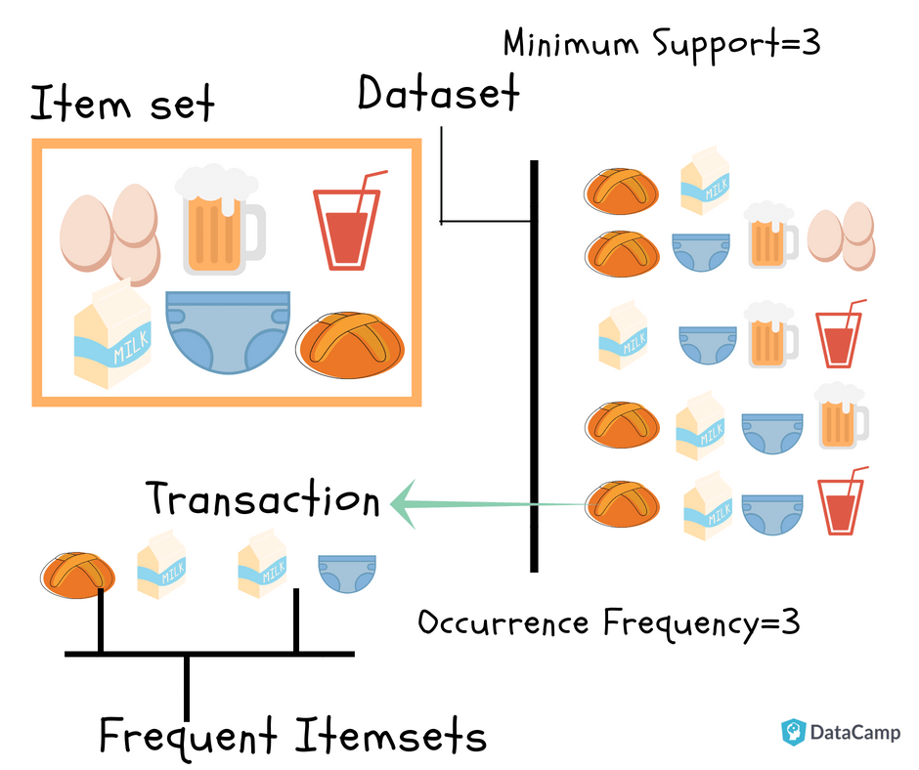
Tech Requirements
Association Rule Learning
Association rule learning algorithms’ goal is to dig into large amounts of data and discover interesting relations between attributes.
Machine Learning Course
Abdel Rahman AlSabbagh
Notes:
For example, suppose you own a supermarket. Running an association rule
on your sales logs may reveal that people who purchase barbecue sauce and potato
chips also tend to buy steak. Thus, you may want to place these items close to each
other.

Slide 41
Tech Requirements
Semisupervised Learning
Some algorithms can deal with partially labeled training data, usually a lot of unlabeled data and a little bit of labeled data. This is called semisupervised learning.
Machine Learning Course
Abdel Rahman AlSabbagh
Notes:
Some photo-hosting services, such as Google Photos, are good examples of this. Once
you upload all your family photos to the service, it automatically recognizes that the
same person A shows up in photos 1, 5, and 11, while another person B shows up in
photos 2, 5, and 7. This is the unsupervised part of the algorithm (clustering). Now all
the system needs is for you to tell it who these people are. Just one label per person,
and it is able to name everyone in every photo, which is useful for searching photos.
Most semisupervised learning algorithms are combinations of unsupervised and
supervised algorithms. For example, deep belief networks (DBNs) are based on unsupervised
components called restricted Boltzmann machines (RBMs) stacked on top of
one another. RBMs are trained sequentially in an unsupervised manner, and then the
whole system is fine-tuned using supervised learning techniques.

Slide 42
Tech Requirements
Reinforcement Learning
The learning system, called an agent in this context, can observe the environment, select and perform actions, and get rewards in return or penalties in the form of negative rewards,
It must then learn by itself what is the best strategy, called a policy, to get the most reward over time. A policy defines what action the agent should choose when it is in a given situation.
Machine Learning Course
Abdel Rahman AlSabbagh
Notes:
For example, many robots implement Reinforcement Learning algorithms to learn
how to walk. DeepMind’s AlphaGo program is also a good example of Reinforcement
Learning: it made the headlines in May 2017 when it beat the world champion Ke Jie
at the game of Go. It learned its winning policy by analyzing millions of games, and
then playing many games against itself. Note that learning was turned off during the
games against the champion; AlphaGo was just applying the policy it had learned.

Slide 43
Tech Requirements
Recap
Types of Machine Learning Systems
Supervised/Unsupervised Learning
Batch and Online Learning
Instance-Based Versus Model-Based Learning
Supervised learning
Unsupervised learning
Semisupervised learning
Reinforcement Learning
Machine Learning Course
Abdel Rahman AlSabbagh

Slide 44
Tech Requirements
Batch and Online Learning
Another criterion used to classify Machine Learning systems is whether or not the system can learn incrementally from a stream of incoming data.
There are two main approaches: batch learning and online learning.
Machine Learning Course
Abdel Rahman AlSabbagh

Slide 45
Tech Requirements
Batch Learning
In batch learning, the system is incapable of learning incrementally: it must be trained using all the available data. This will generally take a lot of time and computing resources, so it is typically done offline.
First the system is trained, and then it is launched into production and runs without learning anymore; it just applies what it has learned. This is called offline learning.
Machine Learning Course
Abdel Rahman AlSabbagh
Notes:
If you want a batch learning system to know about new data (such as a new type of
spam), you need to train a new version of the system from scratch on the full dataset
(not just the new data, but also the old data), then stop the old system and replace it
with the new one.
Fortunately, the whole process of training, evaluating, and launching a Machine
Learning system can be automated fairly easily, so even a
batch learning system can adapt to change. Simply update the data and train a new
version of the system from scratch as often as needed.
This solution is simple and often works fine, but training using the full set of data can
take many hours, so you would typically train a new system only every 24 hours or
even just weekly. If your system needs to adapt to rapidly changing data (e.g., to predict
stock prices), then you need a more reactive solution.
Also, training on the full set of data requires a lot of computing resources (CPU,
memory space, disk space, disk I/O, network I/O, etc.). If you have a lot of data and
you automate your system to train from scratch every day, it will end up costing you a
lot of money. If the amount of data is huge, it may even be impossible to use a batch
learning algorithm.
Finally, if your system needs to be able to learn autonomously and it has limited
resources (e.g., a smartphone application or a rover on Mars), then carrying around
large amounts of training data and taking up a lot of resources to train for hours
every day is a showstopper.
Fortunately, a better option in all these cases is to use algorithms that are capable of
learning incrementally.

Slide 46
Tech Requirements
Online Learning
In online learning, you train the system incrementally by feeding it data instances sequentially, either individually or by small groups called mini-batches. Each learning step is fast and cheap, so the system can learn about new data on the fly, as it arrives.
Machine Learning Course
Abdel Rahman AlSabbagh
Notes:
Online learning is great for systems that receive data as a continuous flow (e.g., stock
prices) and need to adapt to change rapidly or autonomously. It is also a good option.
if you have limited computing resources: once an online learning system has learned
about new data instances, it does not need them anymore, so you can discard them
(unless you want to be able to roll back to a previous state and “replay” the data). This
can save a huge amount of space.

Slide 47
Tech Requirements
Online Learning
Online learning algorithms can also be used to train systems on huge datasets that cannot fit in one machine’s main memory (this is called out-of-core learning). The algorithm loads part of the data, runs a training step on that data, and repeats the process until it has run on all of the data.
Machine Learning Course
Abdel Rahman AlSabbagh
Notes:
Out-of-core learning is usually done offline (i.e., not on the live
system), so online learning can be a confusing name. Think of it as
incremental learning.

Slide 48
Tech Requirements
Online Learning
One important parameter of online learning systems is how fast they should adapt to changing data: this is called the learning rate.
If you set a high learning rate, then your system will rapidly adapt to new data, but it will also tend to quickly forget the old data. (you don’t want a spam filter to flag only the latest kinds of spam it was shown)
Conversely, if you set a low learning rate, the system will have more inertia; that is, it will learn more slowly, but it will also be less sensitive to noise in the new data or to sequences of nonrepresentative data points (outliers).
Machine Learning Course
Abdel Rahman AlSabbagh
Notes:
A big challenge with online learning is that if bad data is fed to the system, the system’s
performance will gradually decline. If we are talking about a live system, your
clients will notice. For example, bad data could come from a malfunctioning sensor
on a robot, or from someone spamming a search engine to try to rank high in search
results. To reduce this risk, you need to monitor your system closely and promptly
switch learning off (and possibly revert to a previously working state) if you detect a
drop in performance. You may also want to monitor the input data and react to
abnormal data (e.g., using an anomaly detection algorithm).

Slide 49
Tech Requirements
Recap
Types of Machine Learning Systems
Supervised/Unsupervised Learning
Batch and Online Learning
Instance-Based Versus Model-Based Learning
Supervised learning
Unsupervised learning
Semisupervised learning
Reinforcement Learning
Machine Learning Course
Abdel Rahman AlSabbagh

Slide 50

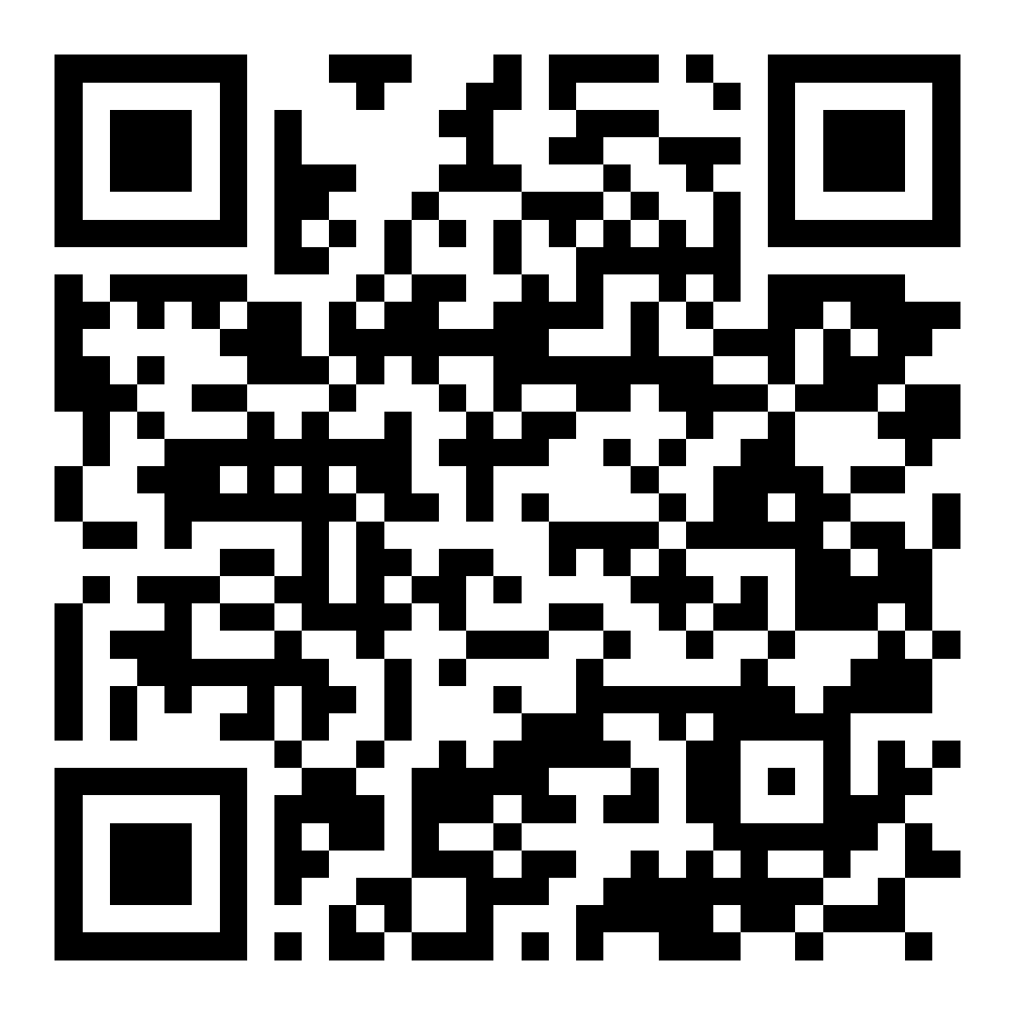
Thank You
Next lecture will be online on sat, 13.5.2023, In Shaa allah!
sabbagh@ieee.org
Connect on Linkedin

